Slide 1
Stigmergy for Multi-Robot Coverage: Design Presentation
Michael Chadwick

Slide 2
Project aims
Construct a Dark Room
Small enough to fit on a table approximately one meter in diameter
Quick to set up; Quick to dismantle
Uses glow in the dark foil as flooring
Code a program to demonstrate the effectiveness of the Dark Room
Target System: e-Puck platform
Should interact with the glowing floor in some manner

Slide 3
Related Research
Products of Research
StiCo: Ranjbar-Sahraei
BeePCo / HybaCo: Caliskanelli / Broecker
Materials Research
Layering
Textured materials

Slide 4
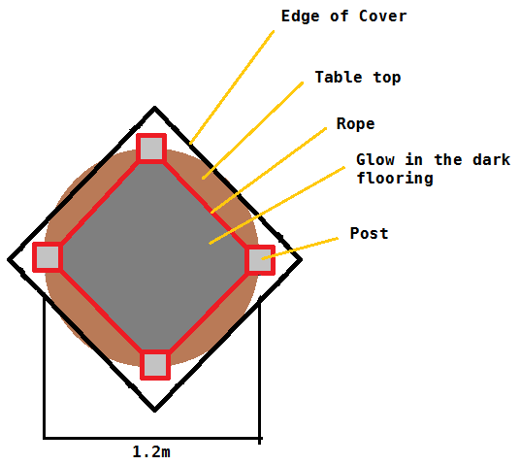
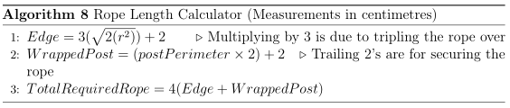
Component: Arena
Portability
4 Materials, not including table
Can fit in a Gym bag
Flexibility
Posts define arena size,
inner face
Rope adapts to posts

Slide 5
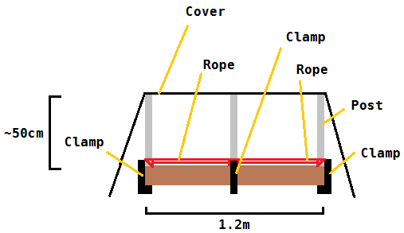
Component: Arena
Rigidity
Clamps hold the posts in place; Rope can be pulled taut
Tripling the rope provides a firm enough barrier
Sheepshank, dogshank, rope shortening knots

Slide 6
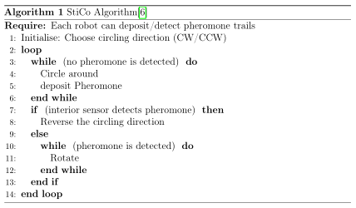
Component: Code
StiCo
Basic Stigmergic algorithm
Fulfills Project aims
Two clear states – when pheromones are detected; when none are found

